Slide 1
THINKVERT TECHNOLOGY LIMITED
THINK DRIVES THE WORLD
Company Presentation

Slide 2
ABOUT US
THINK DRIVES THE WORLD
What is Thinkvert?
Thinkvert is a company focused on inverter(variable frequency drive) and other motion control products R&D, manufacturing, sales and application.
Why does Thinkvert make inverter?
Thinkvert mission is to continuously make high quality, multifunctional and easy to use inverter with honest price to let everyone in the world enjoy a better life through innovative technology so as to promote Chinese motion control industry healthy development.
What do we stand for?
Rejecting shortcut and opportunism. Continuously creating value for our customers. Let our staff proud and our customers satisfied with Thinkvert.
Generous people are often blessed with good luck. Always insist on good products will be proved by time.

Slide 3
MILESTONE
2022
THINK DRIVES THE WORLD
2018
2017
IPO before 2022
2014
Started export
Synchronous motor drives servo drives and multi-drives under developing
2012
Fully implement new software solutions, product performance has been greatly improved
Spent two years for R&D and lanuched our inverter
Established

Slide 4
SALES GROWTH CHART
THINK DRIVES THE WORLD
Unit: $1K
2016 2017 2018 2019 2020 2021 2022
(Forecast)

Slide 5
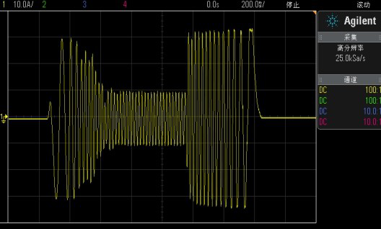
WHY CHOOSE US
THINK DRIVES THE WORLD
HIGH PERFORMANCE
0.1s full-load acceleration and deceleration stable operation
Fast current limit, no tripping operation
Low frequency full load stable operation
Arbitrary acceleration and deceleration and steady state operation, current and voltage stability control
Flying start, smooth and shock-free

Slide 6
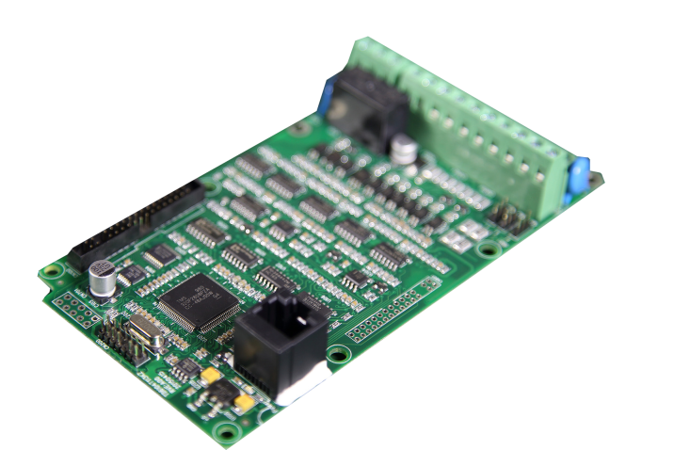
WHY CHOOSE US
THINK DRIVES THE WORLD
HIGH QUALITY COMPONENTS
Infineon 4G IGBT
Infineon, SanRex rectifier bridge
LEM, Kohshin hall sensor
JST terminal
TI DSP
Nidec, Delta cooling fan
Wide temperature adaptation
Wide voltage adaptation
High current detection accuracy
Strong resistance to corrosion and oxidation
Fast response
Long life, low noise

Slide 7
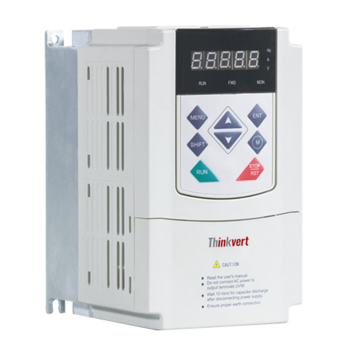
WHY CHOOSE US
THINK DRIVES THE WORLD
ALL IN ONE MODEL
Easy selection
Easy sale
Easy inventory
Easy training
Easy maintenance
Closed loop vector control
Encoder card standard built-in
Simple PLC
Up to 3200HZ
Flying start
Pumping unit function no need braking resistor

Slide 8
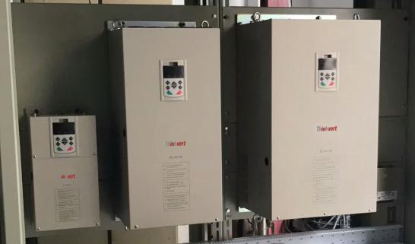
WHY CHOOSE US
THINK DRIVES THE WORLD
HIGH VALUE ADDED
Dimension 30% smaller than domestic inverters, easy install.
Capable of difficult application, value-added for the customers.
Focus on motion control products, continuous improving our products and bringing more value-added products to our customers.
High quality and low failure rate, easy to set up good reputation.
Carefully choose partner. Once choosed, we will establish long-term cooperation. We will continuously create value for our customers and grow together with our customers.

Slide 9
OVERSEAS MARKET PLAN
THINK DRIVES THE WORLD
★
To provide better service to our customers we will establish office in global .

Slide 10
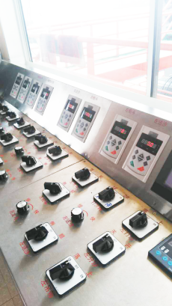
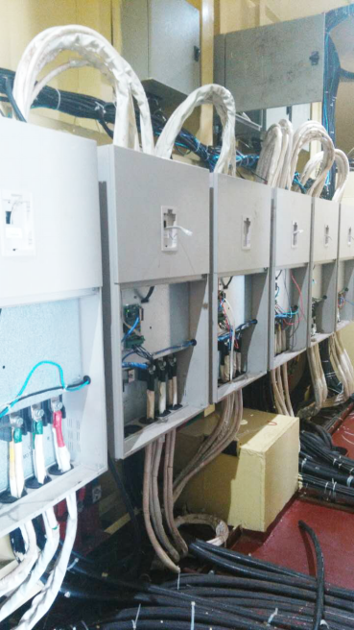
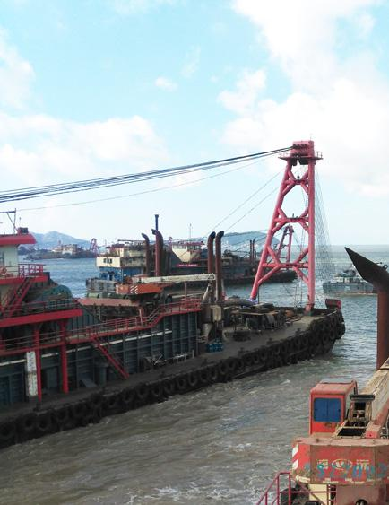
APPLICATION
THINK DRIVES THE WORLD
Dredging Vessel
Reasonable structure design and circuit layout.
Special conformal coating. It could operate stably in wet, salt and fog environment.

Slide 11
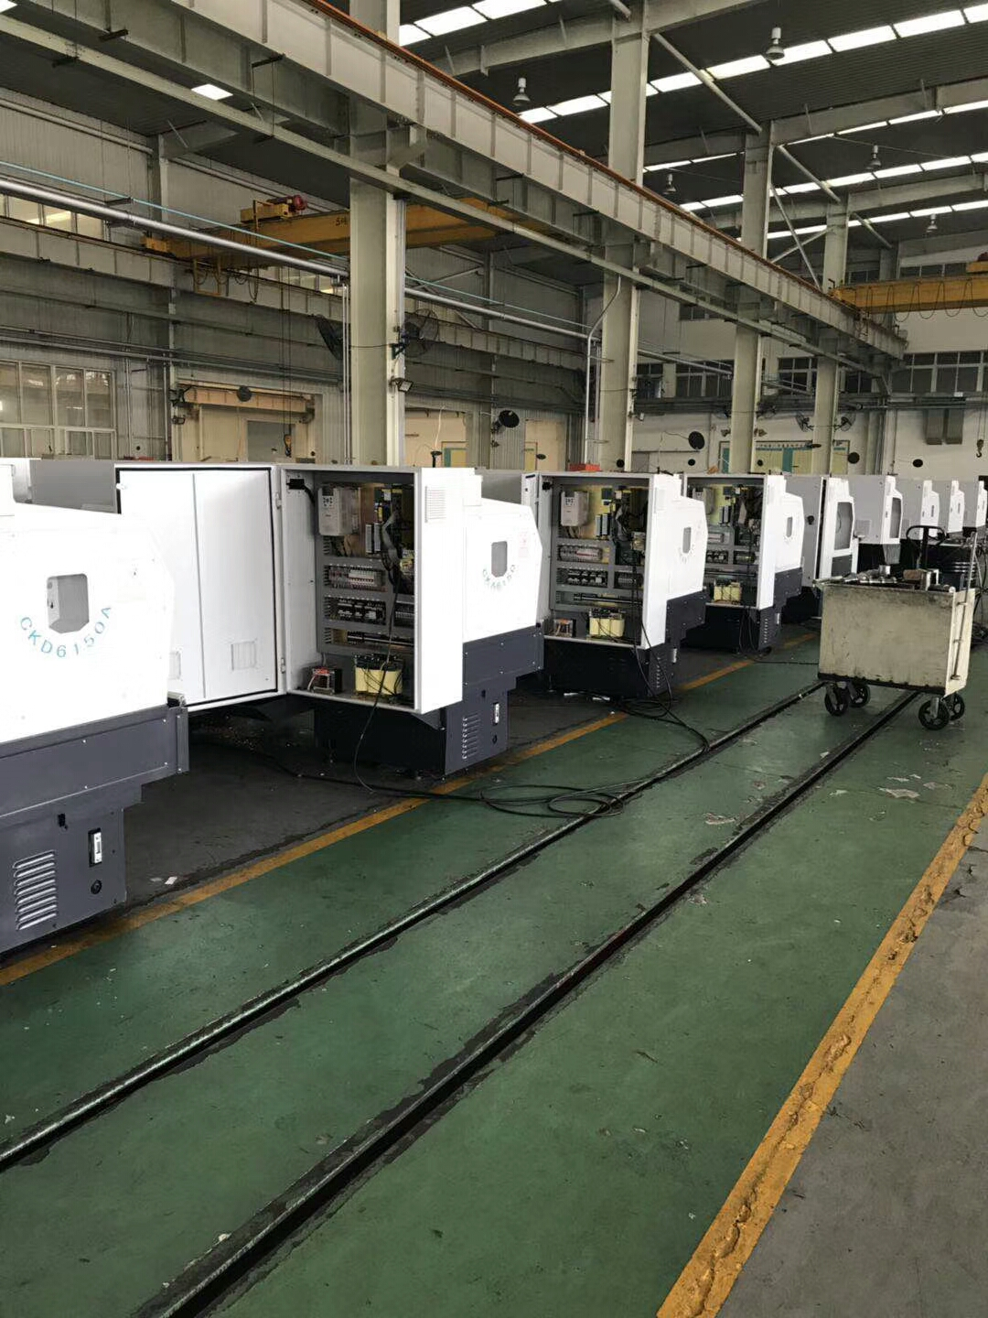
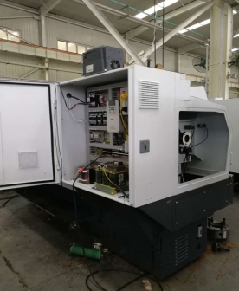
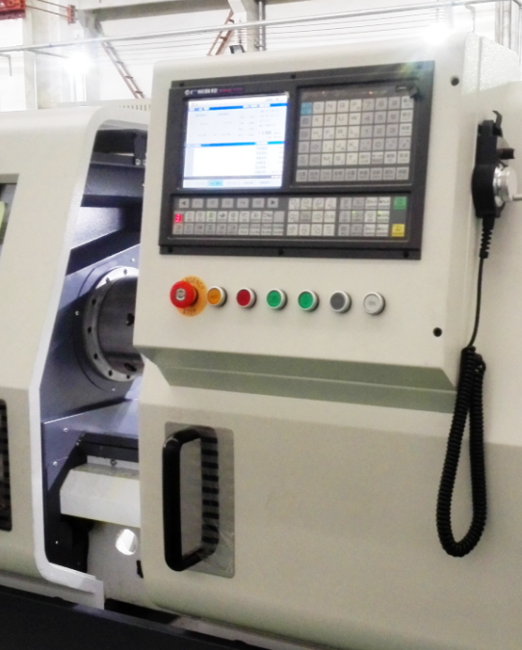
APPLICATION
THINK DRIVES THE WORLD
CNC
Standard up to 3200HZ
High accuracy
High torque in low frequency

Slide 12
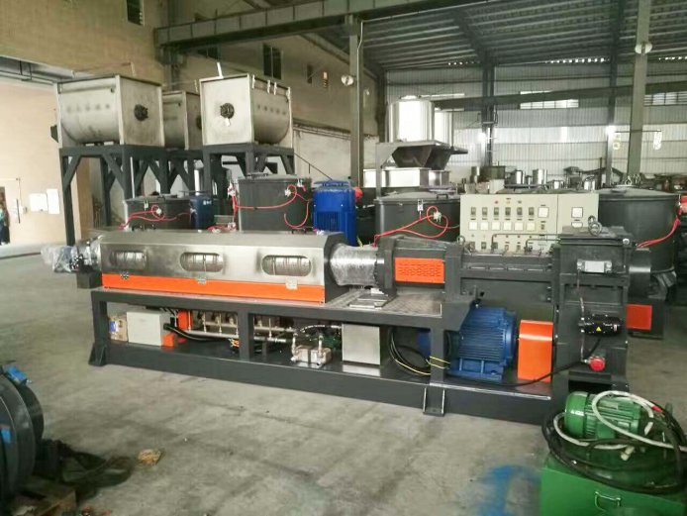
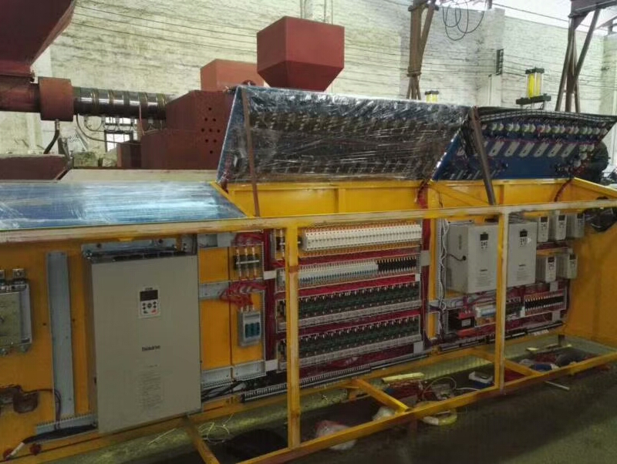
APPLICATION
THINK DRIVES THE WORLD
Extruder
High torque in low frequency.
Compact design, save installation space.

Slide 13
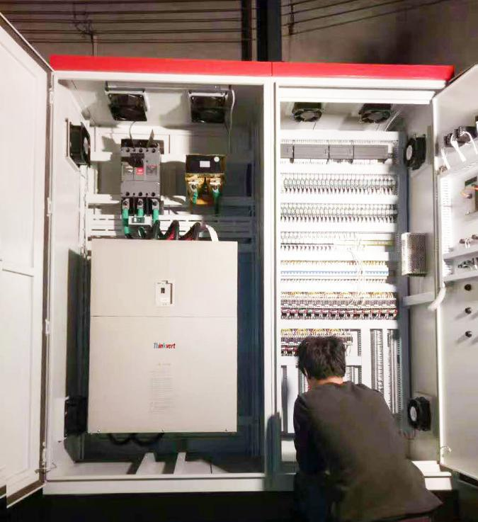
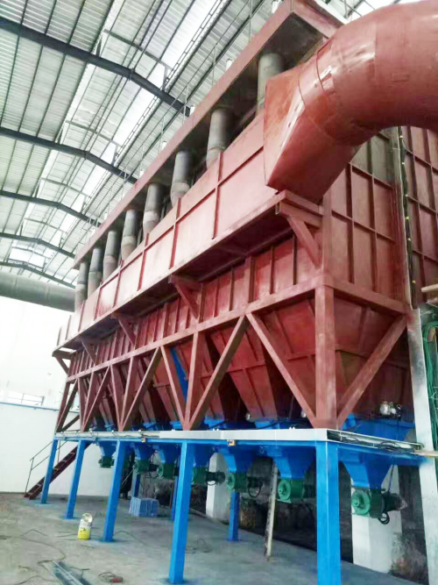
APPLICATION
THINK DRIVES THE WORLD
Fan
Perfect flying start, start fast and low current.

Slide 14
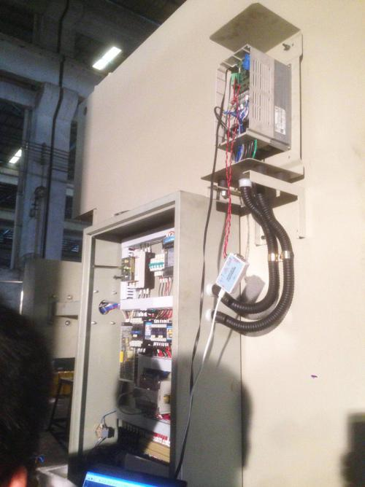
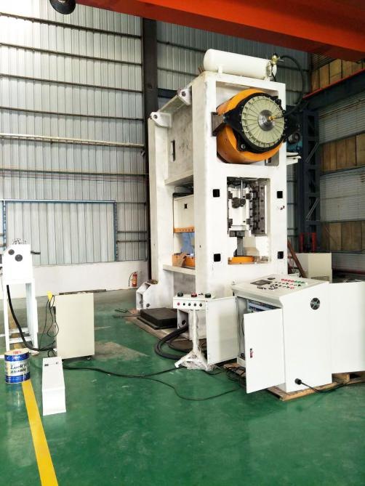
APPLICATION
THINK DRIVES THE WORLD
High speed punch press
Acceleration/deceleration time is short, high work efficiency.
Flying start, rapid recovery from failure, high work efficiency.
Large torque in low frequency stable output, low rejection rate.

Slide 15
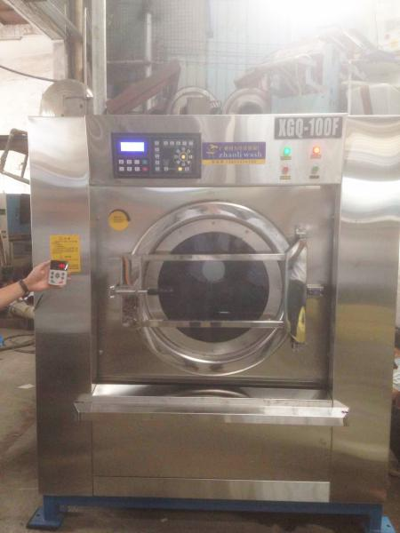
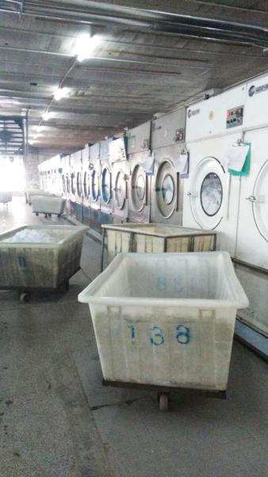
APPLICATION
THINK DRIVES THE WORLD
Industrial Washing Machine
No stall during acceleration and deceleration.
When the secondary feeding water is started, the load reaches the maximum value, and the low-frequency torque output meets the requirements.

Slide 16
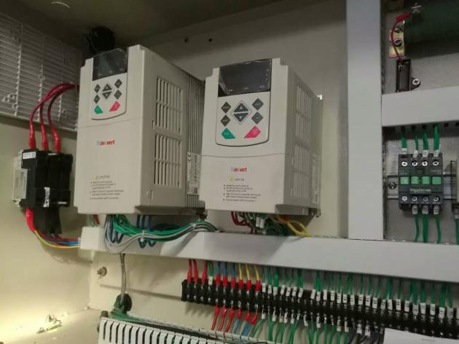
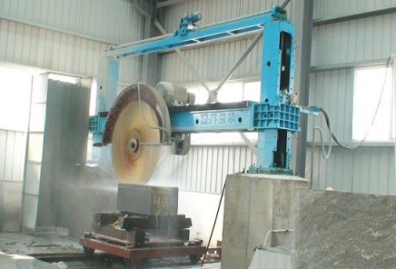
APPLICATION
THINK DRIVES THE WORLD
Stone Cutting Machine
Voltage adaption range is wide, suitable different places.

Slide 17
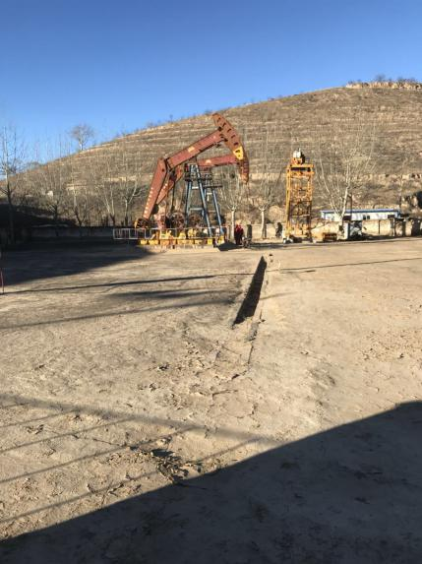
APPLICATION
THINK DRIVES THE WORLD
Oil Pumping Unit
Oil pumping unit dedicated function no need break resistor.
Easy programming. After enable oil pumping unit dedicated function the rest of programming as same as standard.

Slide 18
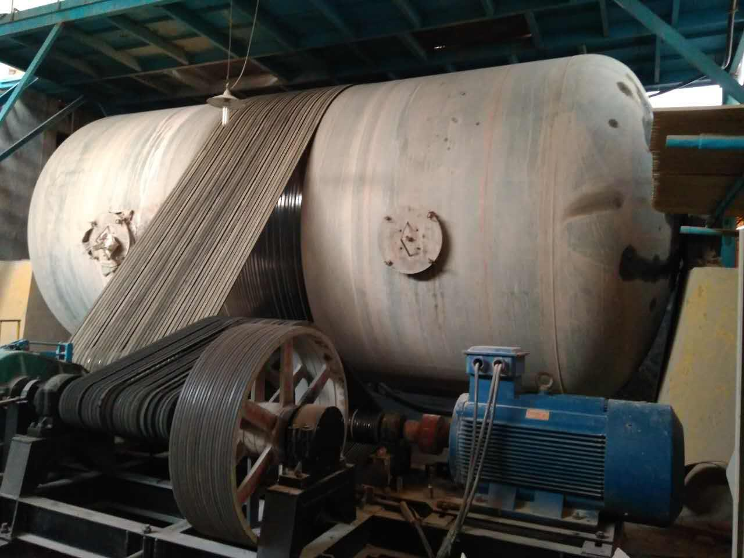
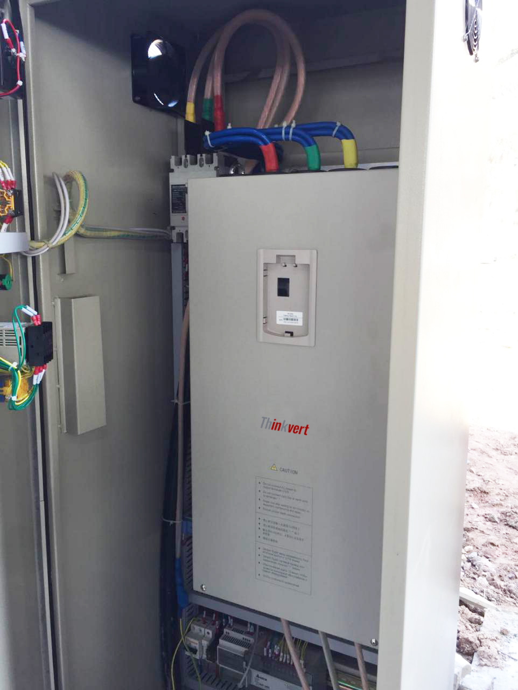
APPLICATION
THINK DRIVES THE WORLD
Ball Mill
Perfect flying start, start fast and low current.

Slide 19
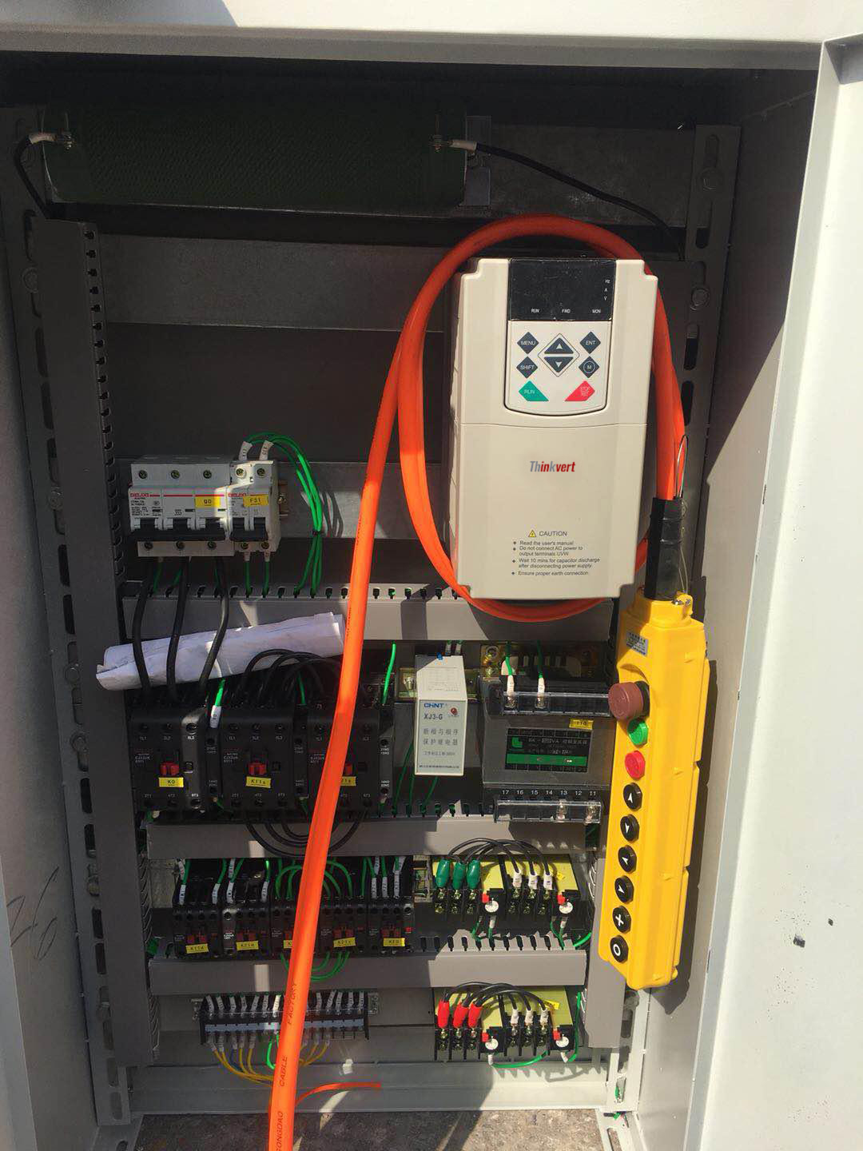
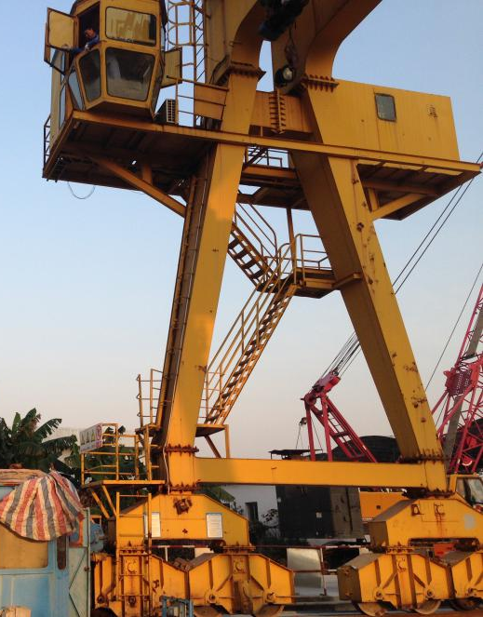
APPLICATION
THINK DRIVES THE WORLD
Crane
Large torque in low frequency, 1HZ enable the braking
Multi logical check, ensure disable braking won't slide hook.
≤22kw standard built-in braking resistor, ≥30kw~≤110kw built-in braking resistor optional.

Slide 20
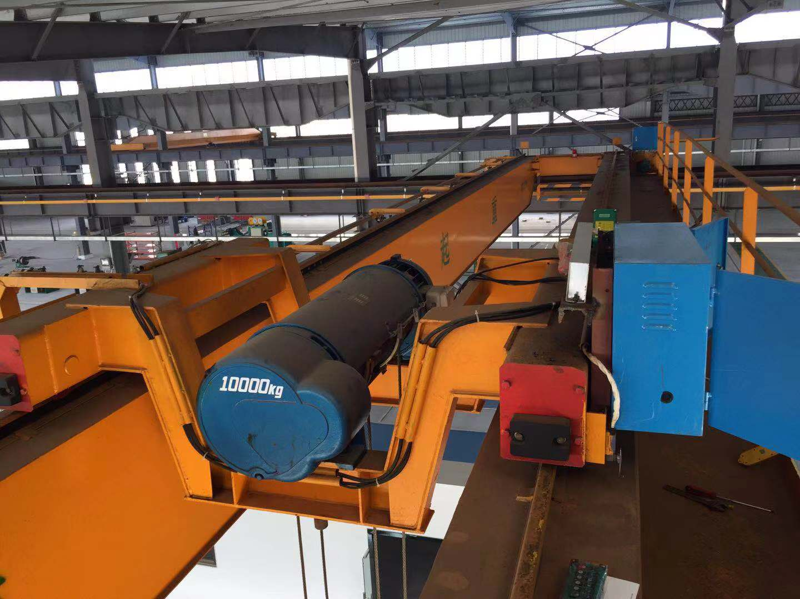
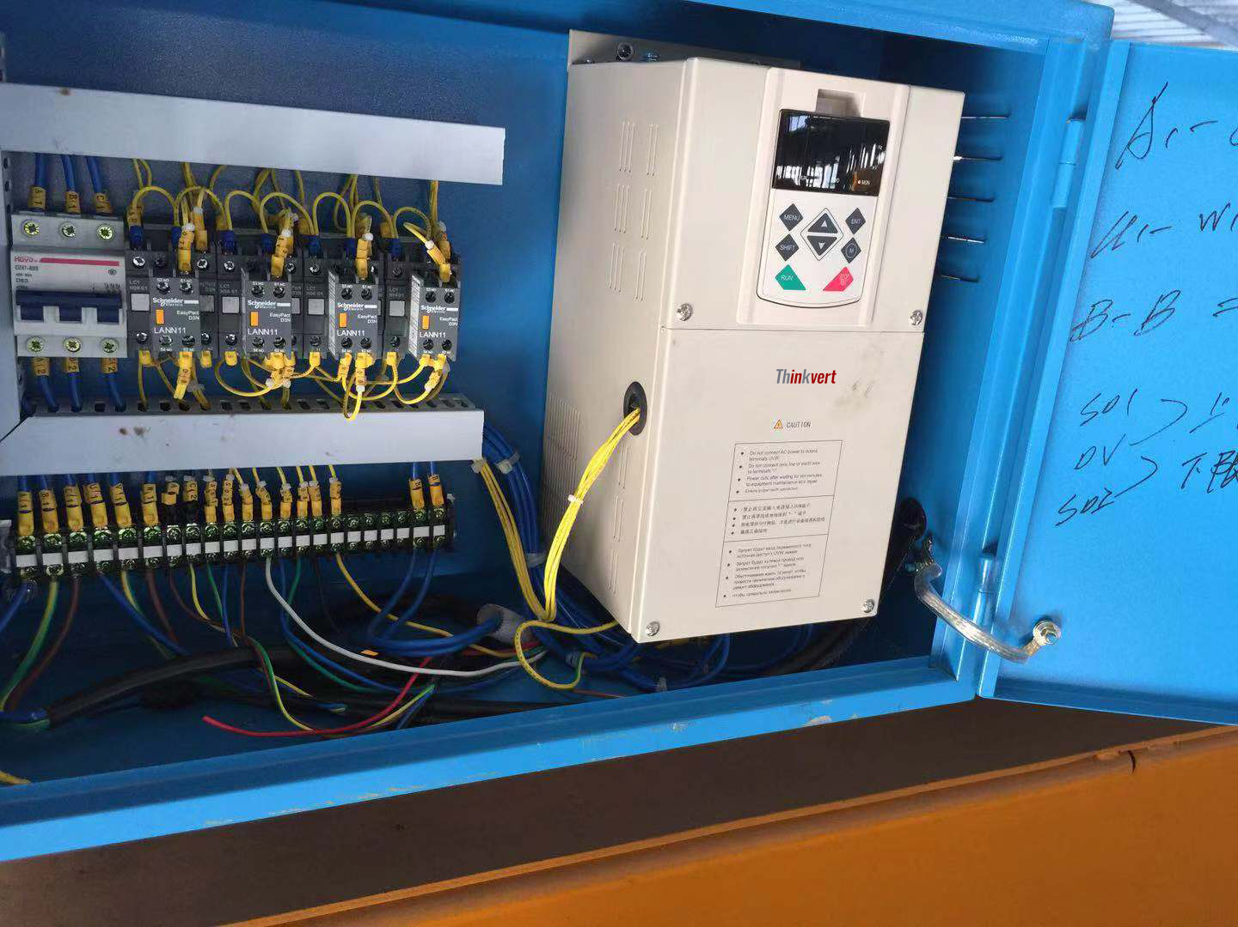
APPLICATION
THINK DRIVES THE WORLD
Crane
Large torque in low frequency, 1HZ enable the braking
Multi logical check, ensure disable braking won't slide hook.
≤22kw standard built-in braking resistor, ≥30kw~≤110kw built-in braking resistor optional.

Slide 21
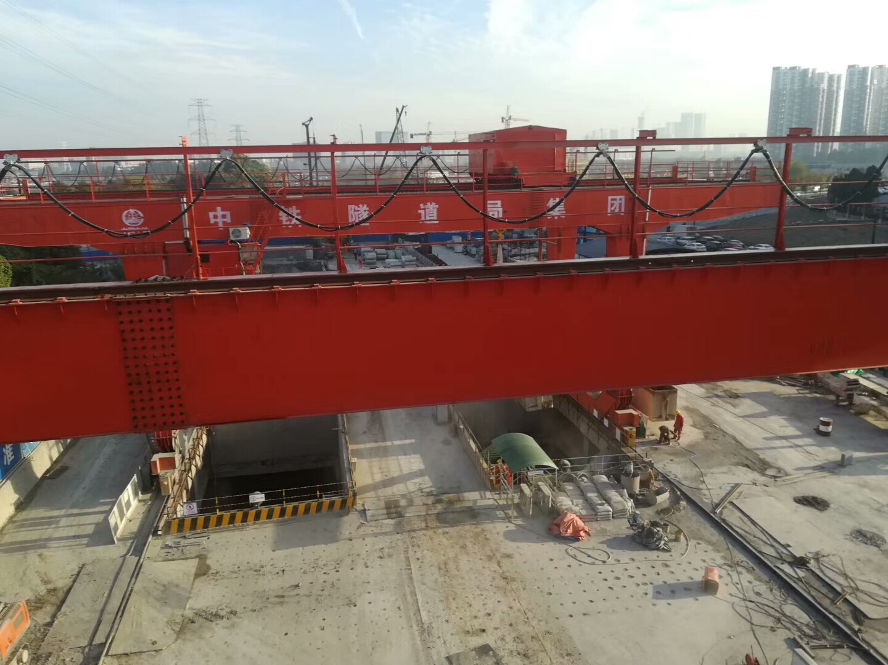
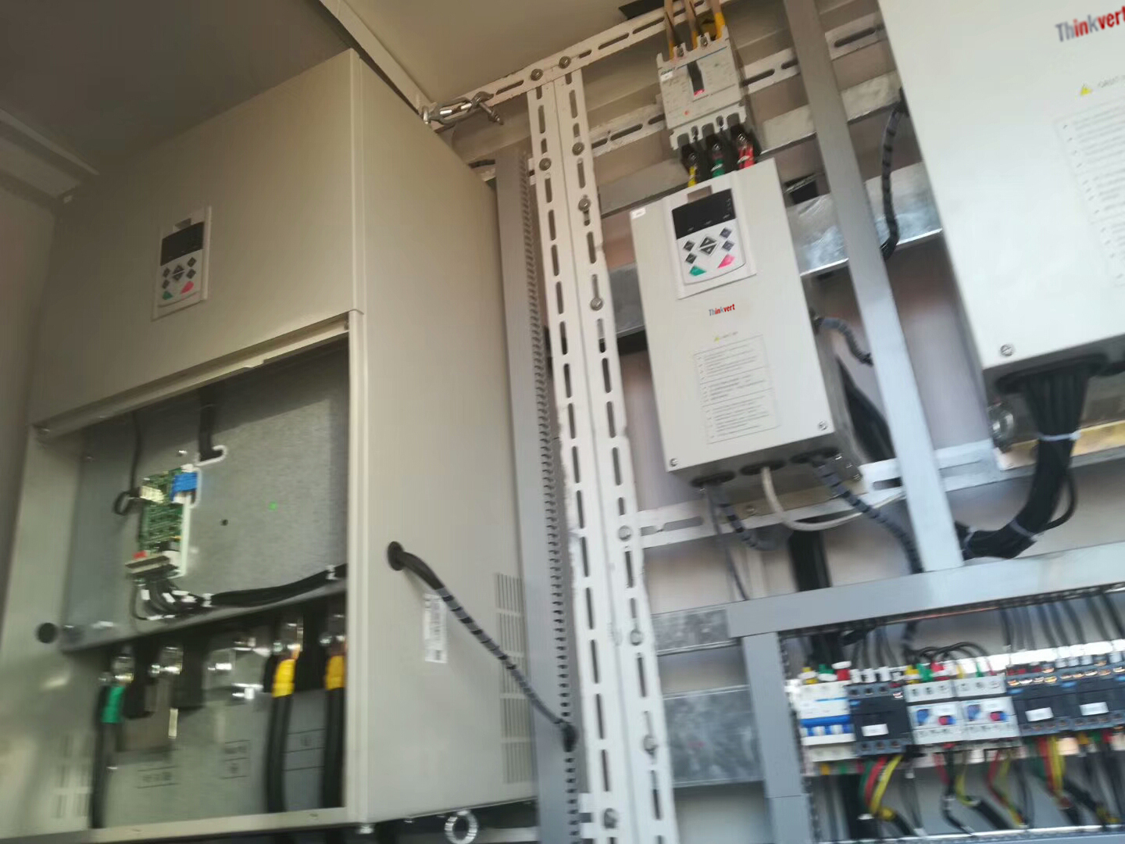
APPLICATION
THINK DRIVES THE WORLD
Crane
Large torque in low frequency, 1HZ enable the braking
Multi logical check, ensure disable braking won't slide hook.
≤22kw standard built-in braking resistor, ≥30kw~≤110kw built-in braking resistor optional.

Slide 22
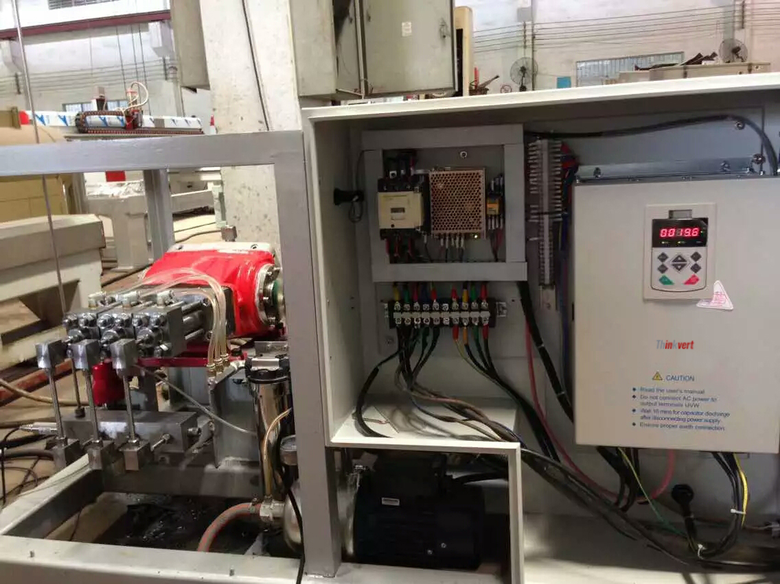
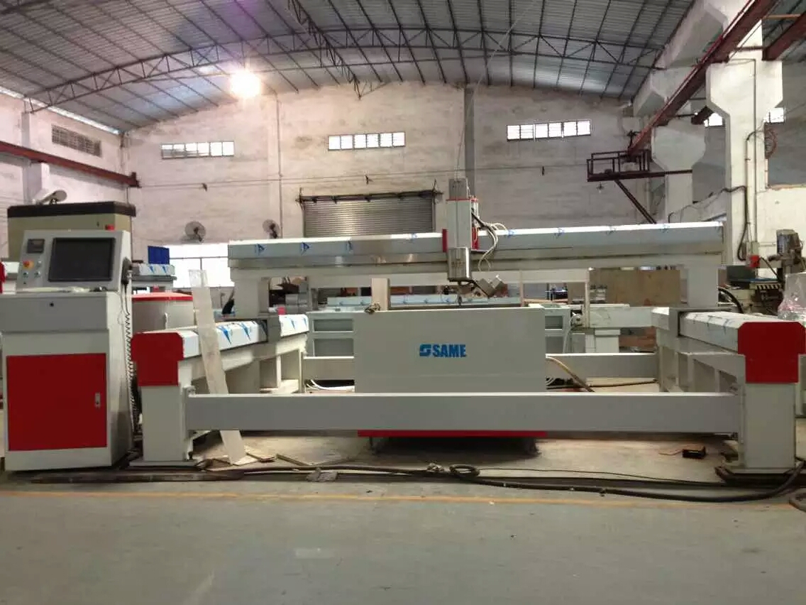
APPLICATION
THINK DRIVES THE WORLD
Water Jet Saw
Stable and reliable operation

Slide 23
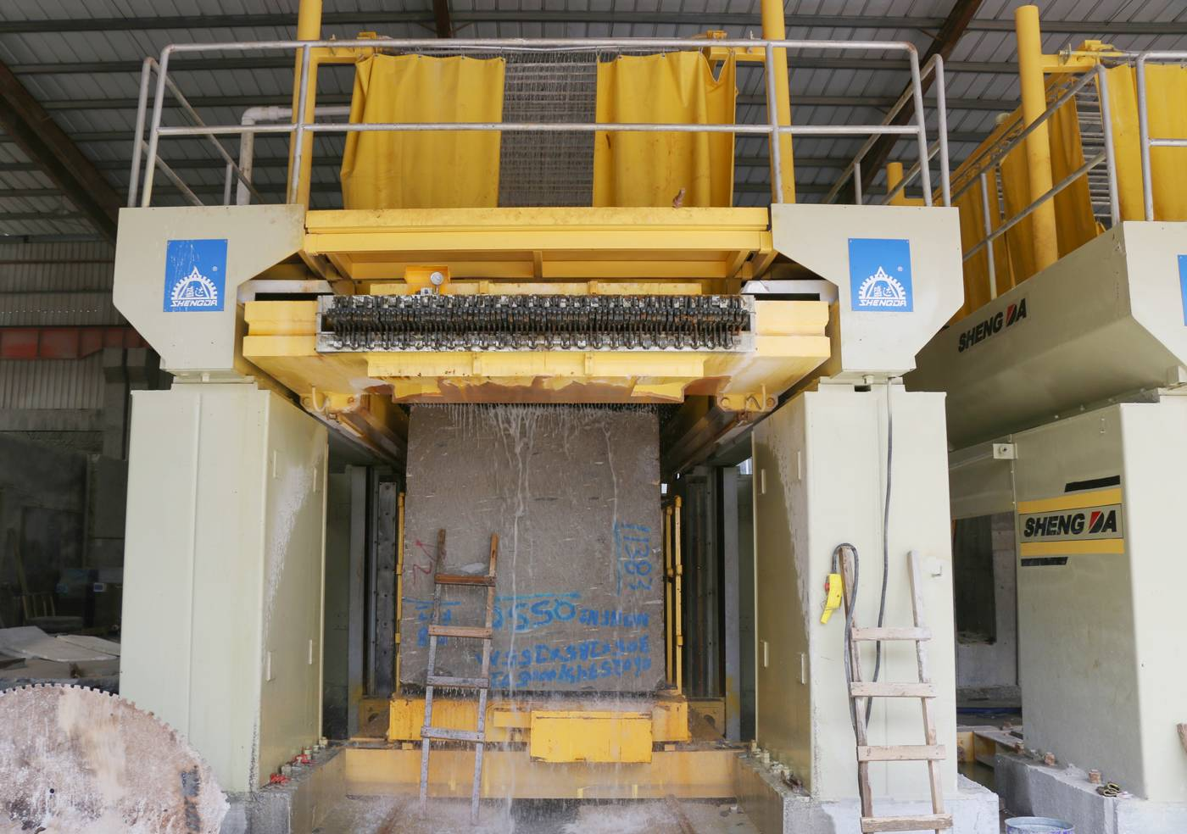
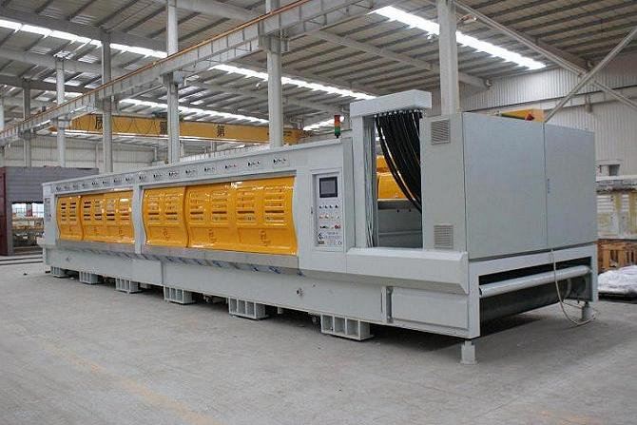
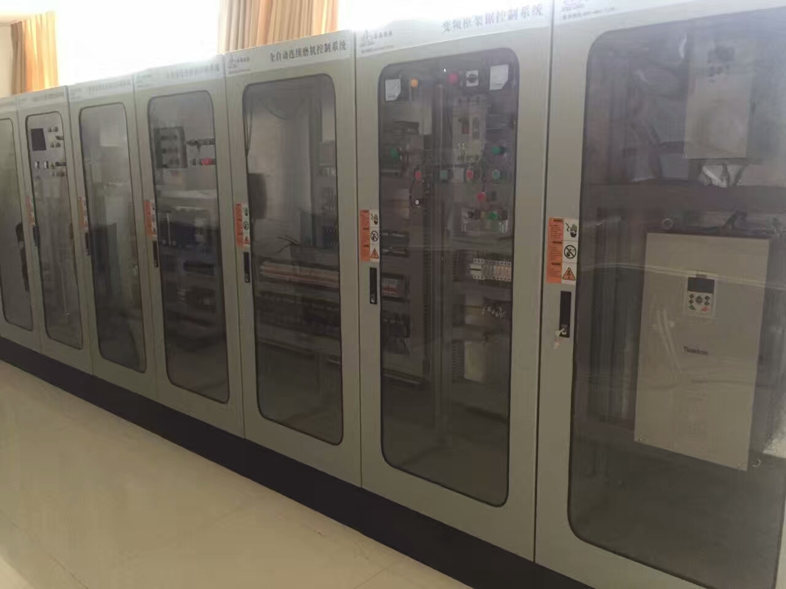
APPLICATION
THINK DRIVES THE WORLD
Continuous Grinder and Frame Saw for Stone Industry
Stable and reliable operation

Slide 24
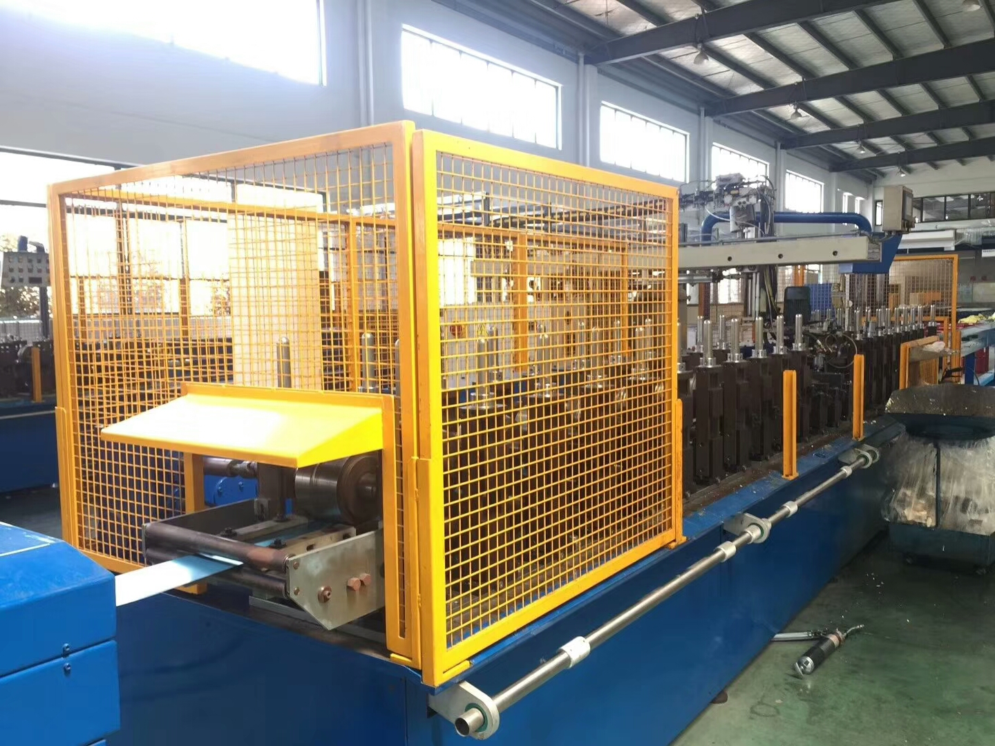
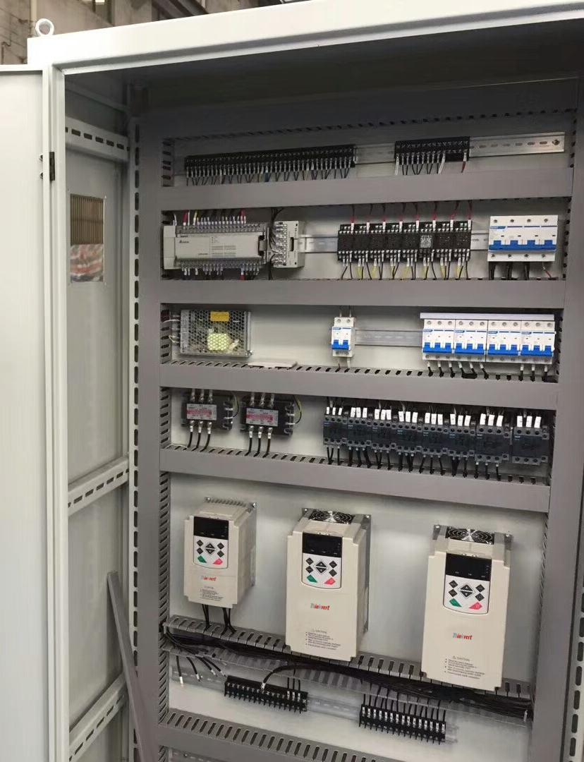
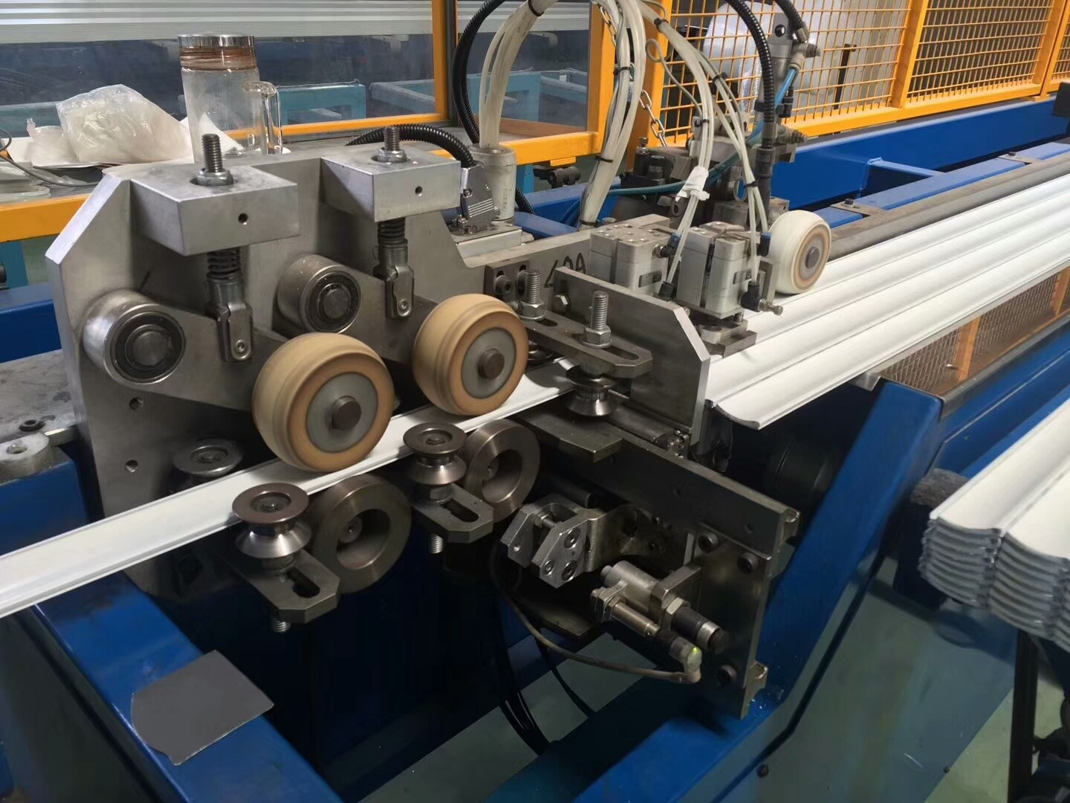
APPLICATION
THINK DRIVES THE WORLD
Cold Bending Machine
Stable and reliable operation

Slide 25
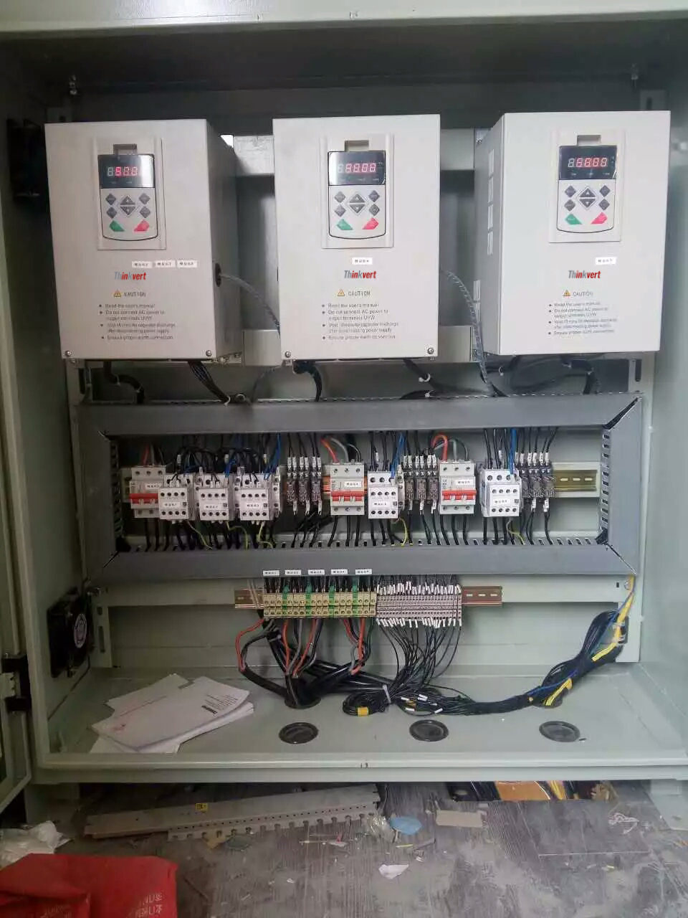
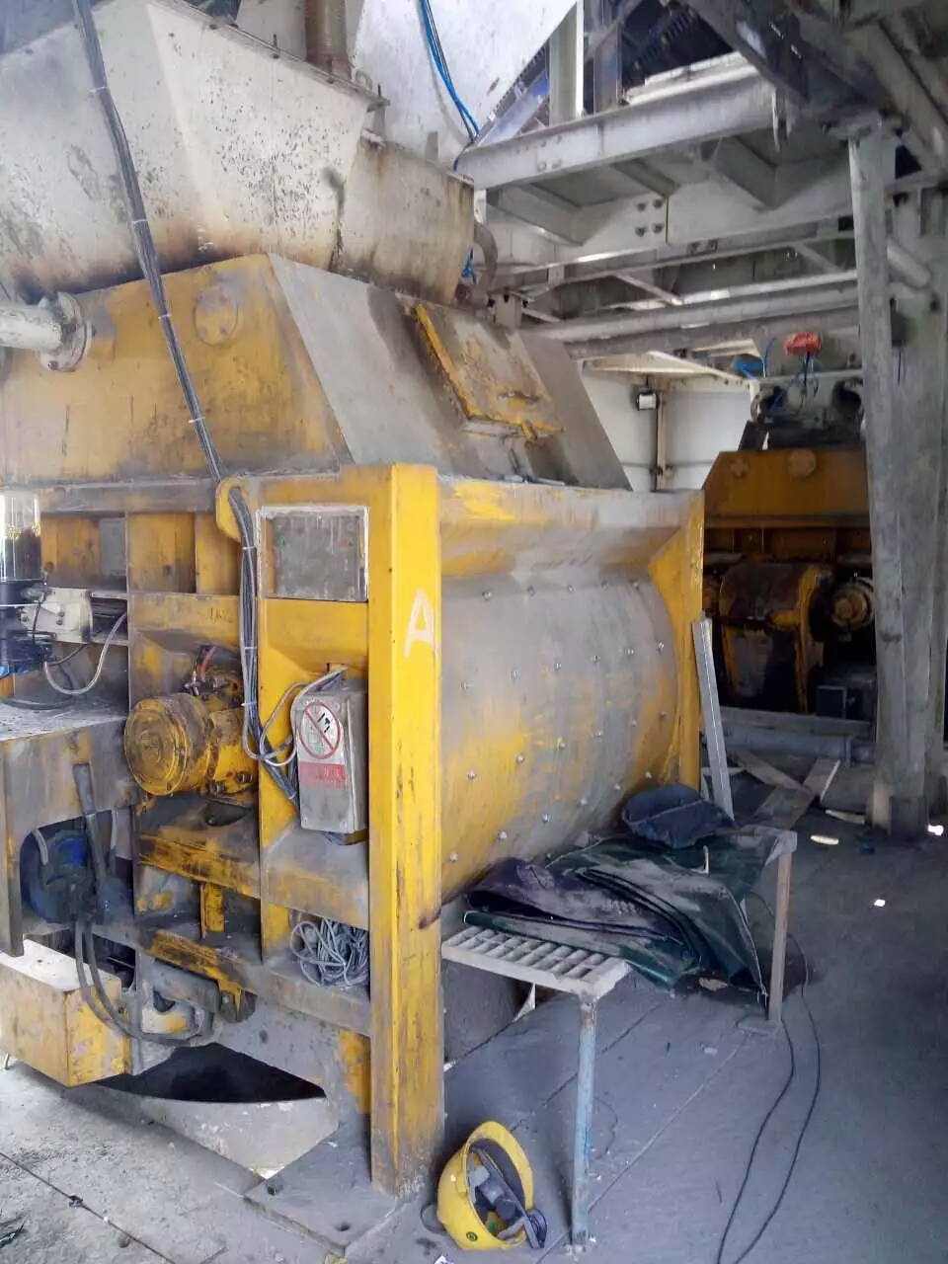
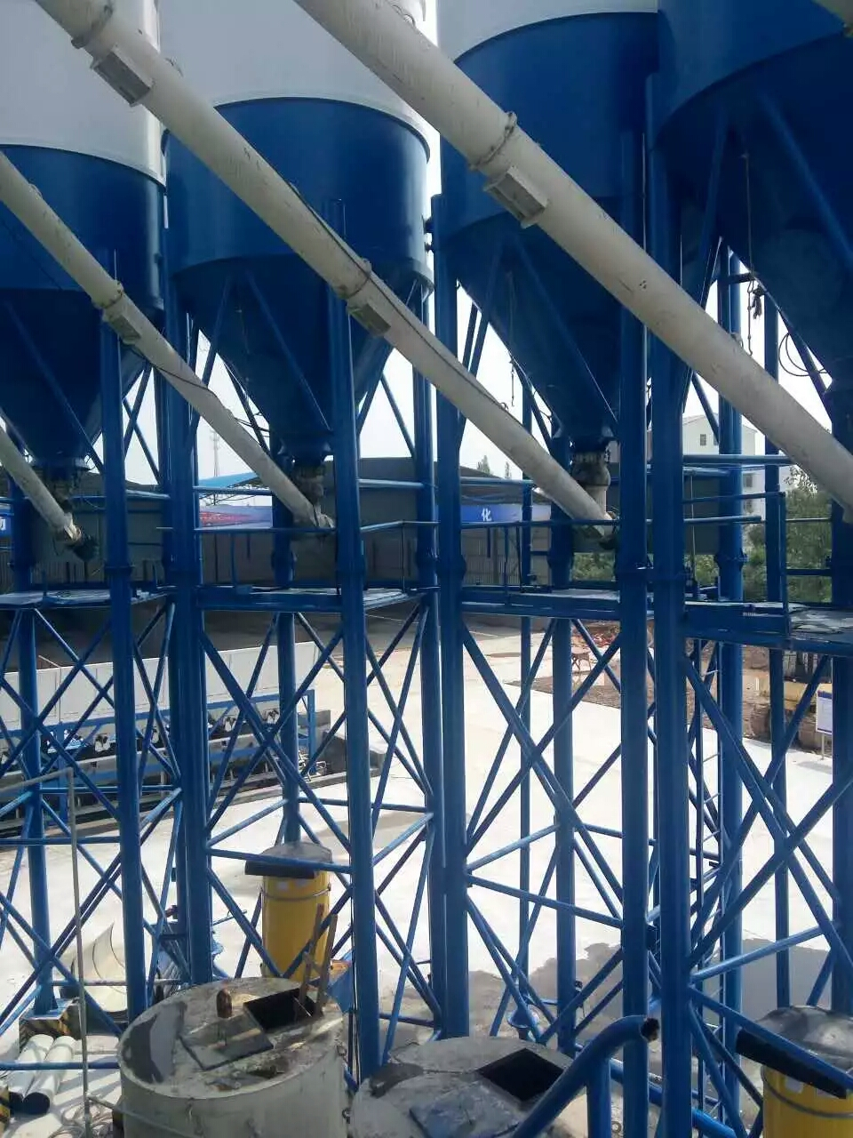
APPLICATION
THINK DRIVES THE WORLD
Cement concrete mixing station
Stable and reliable operation

Slide 26
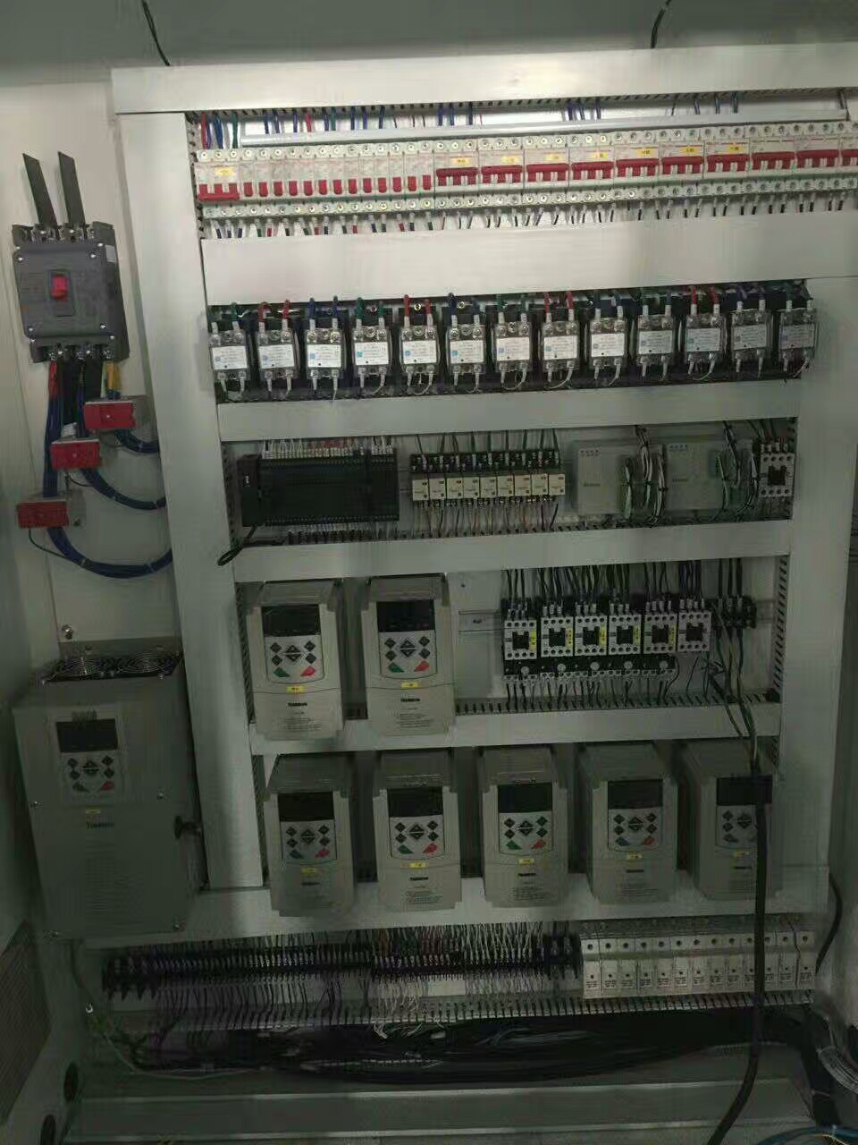
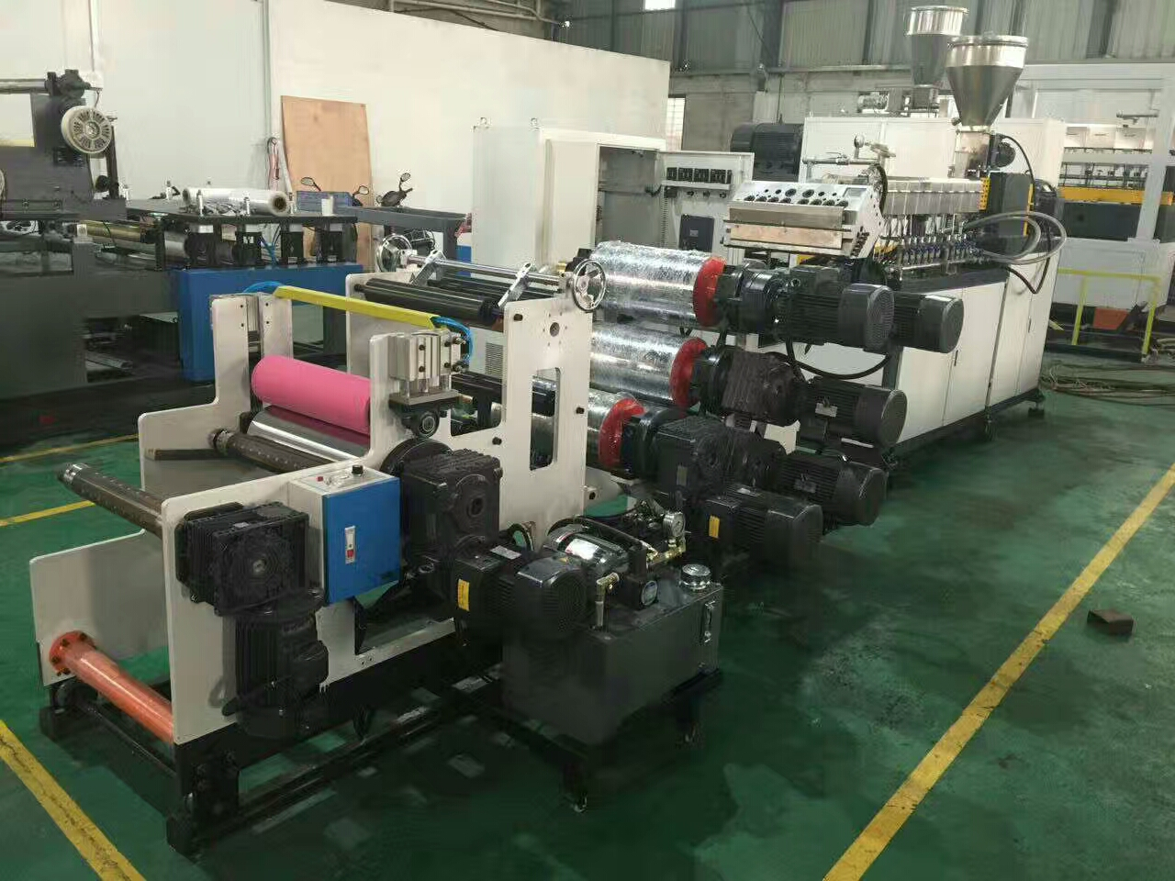
APPLICATION
THINK DRIVES THE WORLD
Plastic Film Machine
Stable and reliable operation

Slide 27
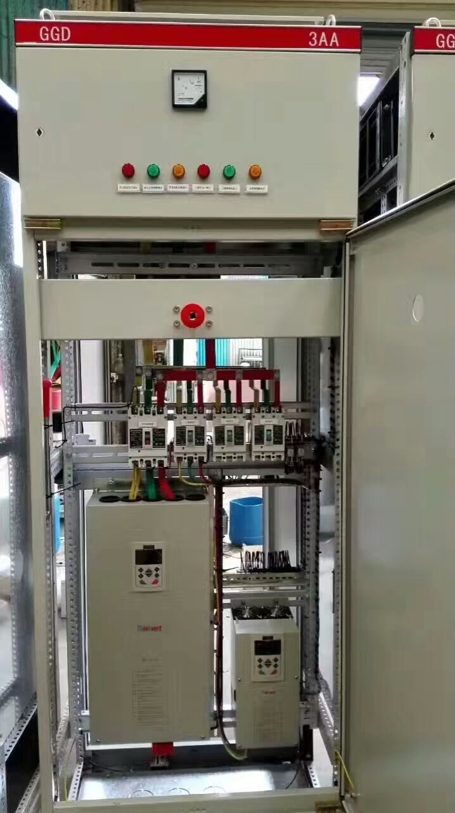
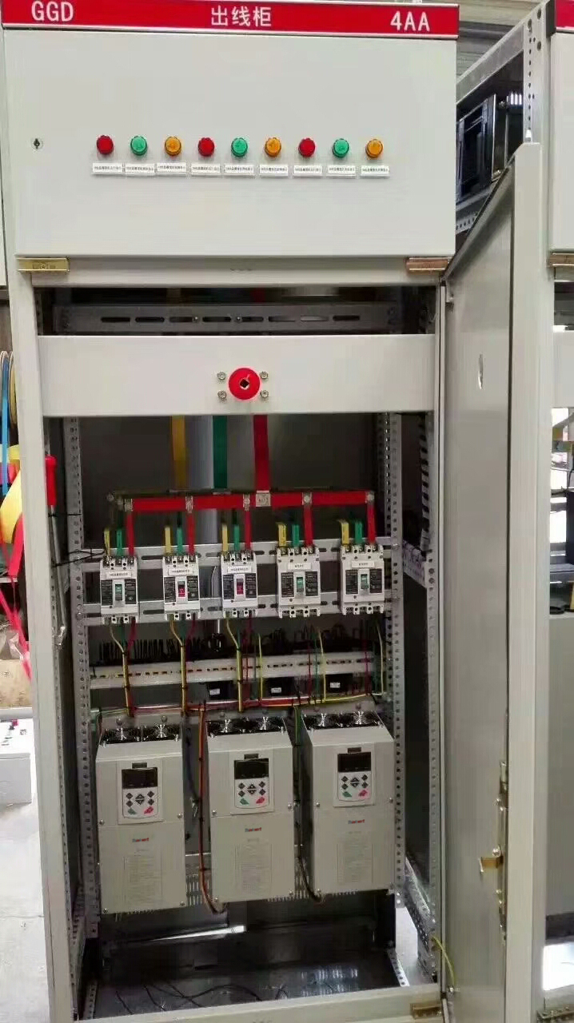
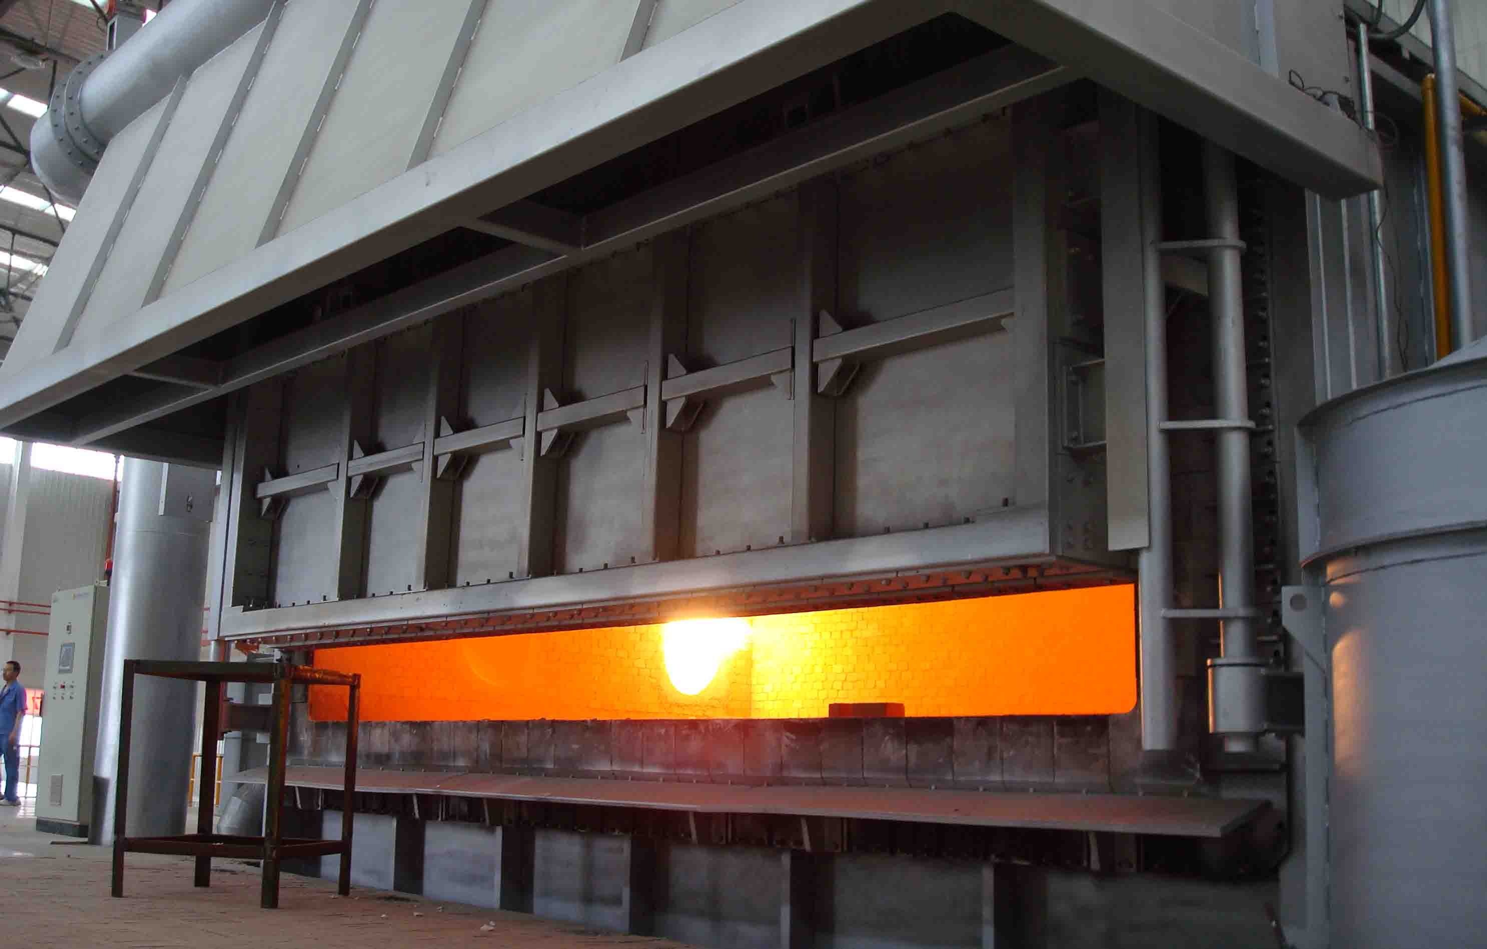
APPLICATION
THINK DRIVES THE WORLD
Aluminum Melting Furnace
Stable and reliable operation

Slide 28
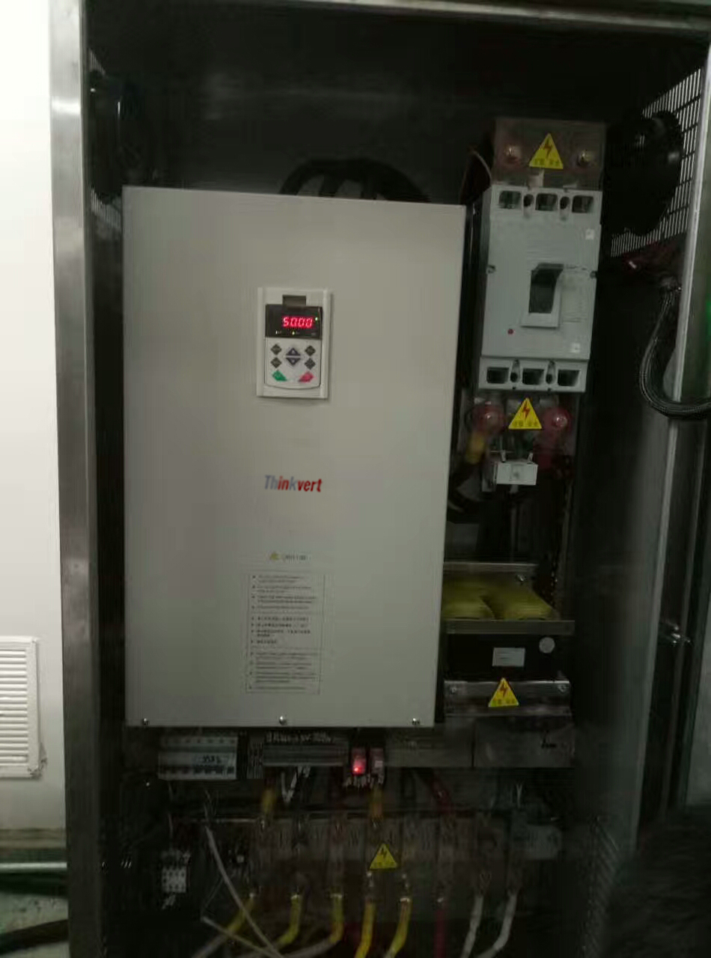
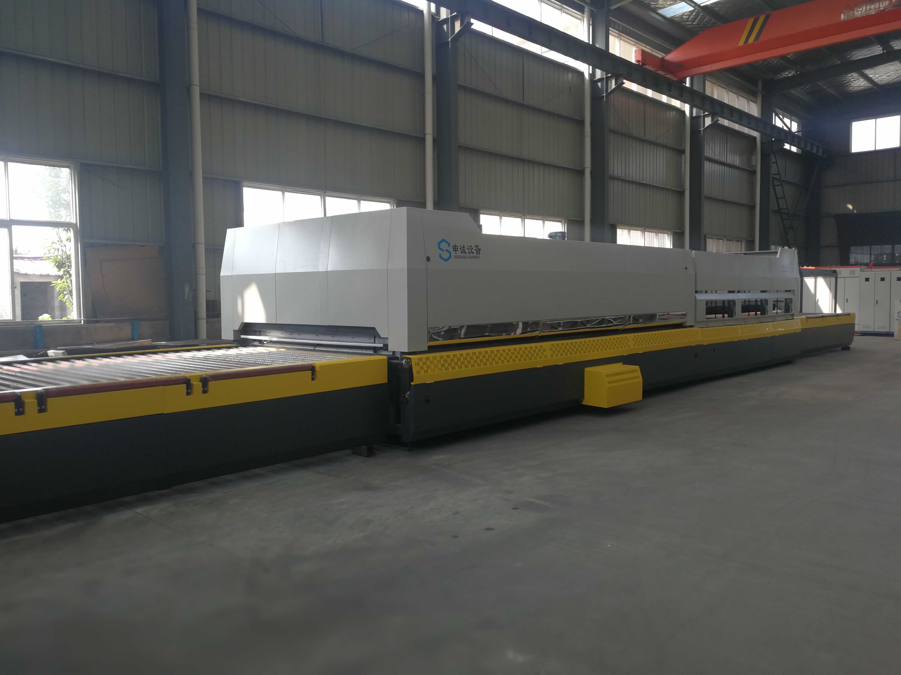
APPLICATION
THINK DRIVES THE WORLD
Tempered Glass Machine
Stable and reliable operation

Slide 29
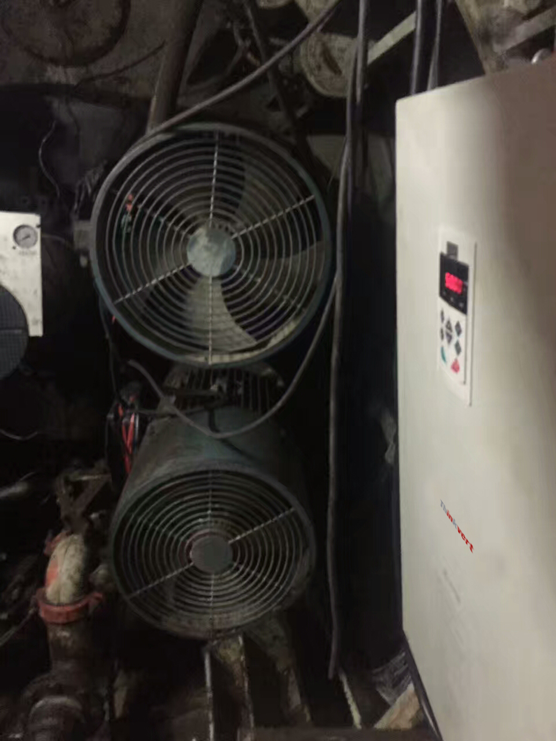
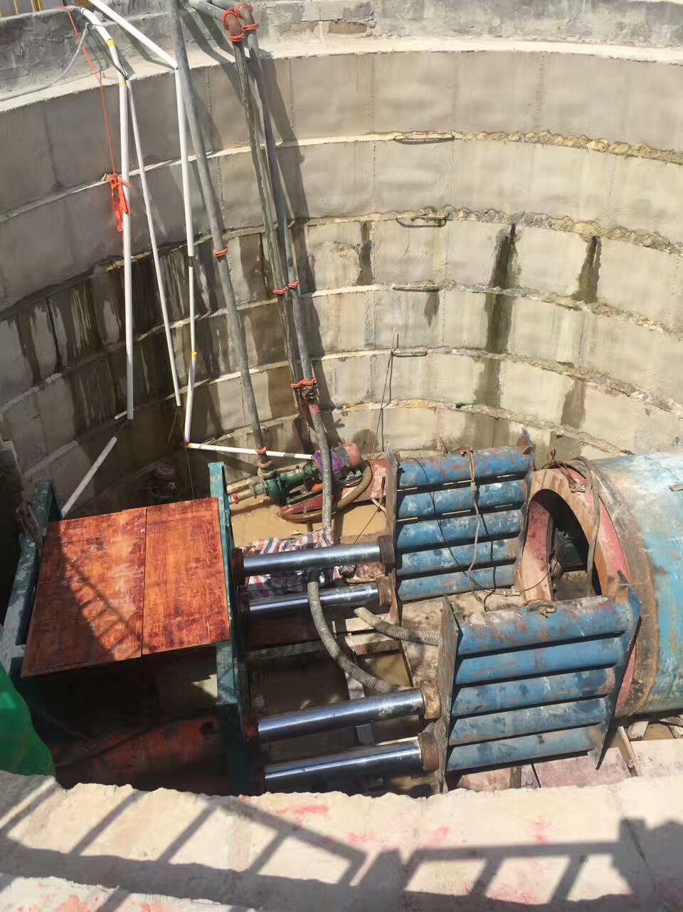
APPLICATION
THINK DRIVES THE WORLD
Sewage Treatment
Stable and reliable operation

Slide 30
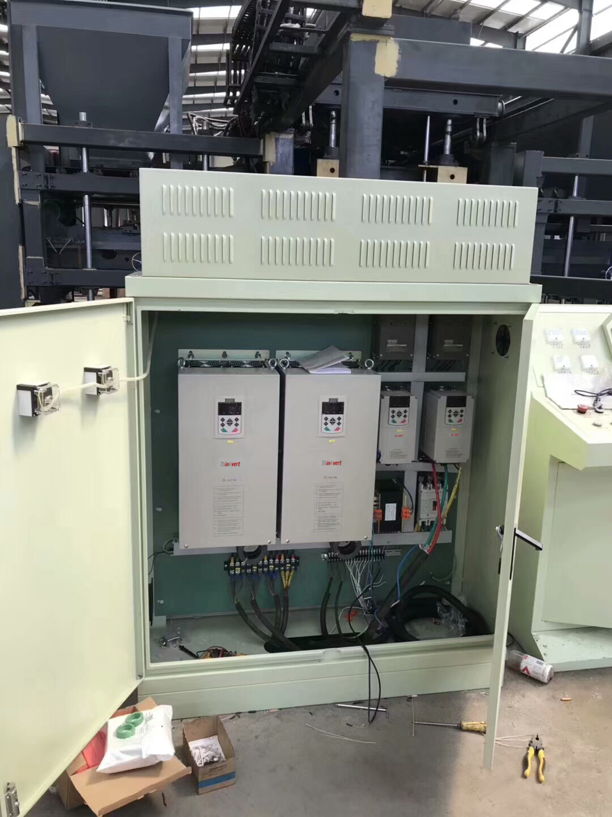
APPLICATION
THINK DRIVES THE WORLD
Ceramic Tile Machine
Stable and reliable operation

Slide 31
APPLICATION
THINK DRIVES THE WORLD
Well Winch
Large torque in low frequency

Slide 32
APPLICATION
THINK DRIVES THE WORLD
Internal Mixer
Large torque in low frequency

Slide 33
APPLICATION
THINK DRIVES THE WORLD
Pelletizer/Granulator
The granulator has large vibration, it is easy to fail frequently if the internal components of VFD is not well-set, Thinkvert VFD is reliable after user proof.

Slide 34
APPLICATION
THINK DRIVES THE WORLD
Veneer Press
Stable and reliable operation

Slide 35
APPLICATION
THINK DRIVES THE WORLD
Leather Rewinder
Perfect torque control and speed control

Slide 36
APPLICATION
THINK DRIVES THE WORLD
Engraving Machines
800HZ, 24000RPM

Slide 37
APPLICATION
THINK DRIVES THE WORLD
Carpentry Engraving Machine
Stable and reliable operation

Slide 38
APPLICATION
THINK DRIVES THE WORLD
Plastic Mixer
Stable and reliable operation

Slide 39
APPLICATION
THINK DRIVES THE WORLD
Coating machine
Perfect torque control and speed control

Slide 40
APPLICATION
THINK DRIVES THE WORLD
Acrylic Film Machine
Stable and reliable operation

Slide 41
APPLICATION
THINK DRIVES THE WORLD
Wire Drawing Machine
Stable and reliable operation

Slide 42
APPLICATION
THINK DRIVES THE WORLD
Homogenizer
55kw homogenizer
Smooth running and low noise

Slide 43
APPLICATION
THINK DRIVES THE WORLD
Brick Machine
Masonry forming has good compactness, smooth surface appearance.
With unique voltage regulator function ,can output enough voltage to drive the motor to work even if the grid voltage is low.

Slide 44
APPLICATION
THINK DRIVES THE WORLD
Die Casting Machine
Energy saving rate up to 30%

Slide 45
APPLICATION
THINK DRIVES THE WORLD
Centrifugal Machine
Long time acceleration and deceleration and high-speed stable operation.
Fast current limiting and voltage limiting to ensure no trip during start and stop.
Large torque in low frequency, quick start when the load is unbalance and the eccentricity is high.

Slide 46
APPLICATION
THINK DRIVES THE WORLD
Sugar Mill
Long time acceleration and deceleration and high-speed stable operation.
Fast current limiting and voltage limiting to ensure no trip during start and stop.
Large torque in low frequency, quick start when the load is unbalance and the eccentricity is high.

Slide 47
APPLICATION
THINK DRIVES THE WORLD
Slitting Machine
Perfect torque control and speed control

Slide 48
APPLICATION
THINK DRIVES THE WORLD
Steel Bar Making Machine
Use 4G Infineon IGBT, inverter working environment temperature up to 60℃

Slide 49
APPLICATION
THINK DRIVES THE WORLD
Wire Drawing Machine
Constant torque stable output, low rejection rate.

Slide 50
APPLICATION
THINK DRIVES THE WORLD
Spinning Frame
Low yarn broken, high working efficiency.

Slide 51
APPLICATION
THINK DRIVES THE WORLD
Paper Cutting Machine
Fast braking, good consistency, meet the accuracy requirements of the paper cutter

Slide 52
APPLICATION
THINK DRIVES THE WORLD
Air Compressor
High energy saving rate, prolong air compressor life-span.

Slide 53
APPLICATION
THINK DRIVES THE WORLD
Blow Molding Machine
Perfect torque control, thin film tightness properly.

Slide 54
Thanks!
THINKVERT TECHNOLOGY LIMITED
Address: Guangming Industiral Park No.21, Dongcheng Street, Dongguan, P.R.China
TEL: +86-0769-33681702
WEB: www.thinkvert.com
EMAIL: info@thinkvert.com
THINK DRIVES THE WORLD

